Slide 1
Environmental Data Summary workshop
Kisei R. Tanaka
PIFSC/ESD/ARP
April 22, 2021

Slide 2
Prereq
R
Rstudio
Survey data with lat, lon, time columns
Git (https://git-scm.com/downloads)
Pifsc VPN and access to M: and G: drives
Know how ERDDAP works.

Slide 3
Topics
1. Environmental Data Summary (EDS) project
2. git-based version control system
3. ERDDAP - OceanWatch & CoastWatch
4. Clone & Run EDS program
5. Branch & customize EDS R codes for your own research

Slide 4
Environmental Data Summary (EDS) project
Enhance in situ data with relevant external environmental data (SST, Chl_a, Bathymetry…)
Useful for subsequent correlative & statistical analyses.
Originally conceptualized & developed by T.A. Oliver
Revised and maintained by K.A. Tanaka & T.A. Oliver
kisei.tanaka@noaa.gov & thomas.oliver@noaa.gov
Citation:
Tanaka KR, Oliver TA (2021) NOAA's National Coral Reef Monitoring Program Environmental Data Summary
Notes:
Tanaka KR, Oliver TA (2021) NOAA's National Coral Reef Monitoring Program Environmental Data Summary

Slide 5
Two types of environmental data
Static (cilmatologies, e.g., average SST 1980-2020)
Dynamic (timeseries, e.g., daily SST)

Slide 6
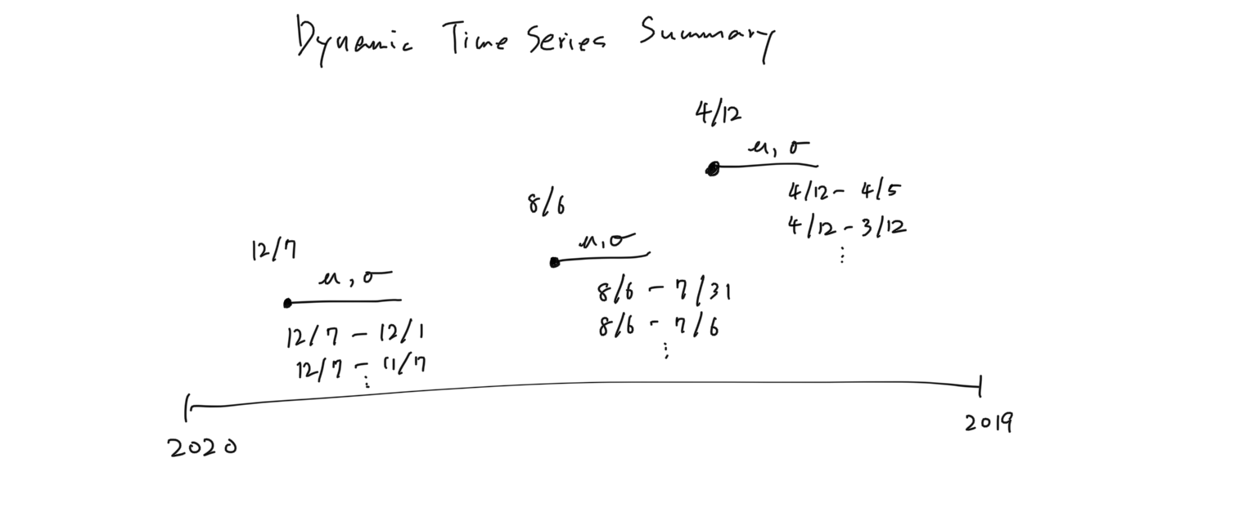
A statistically summarized environmental value (mean, max, min, ci95, sd, 5th and 95th quantiles) computed over past 3 days, week, 1 year, 3 years…etc from any given survey date.

Slide 7
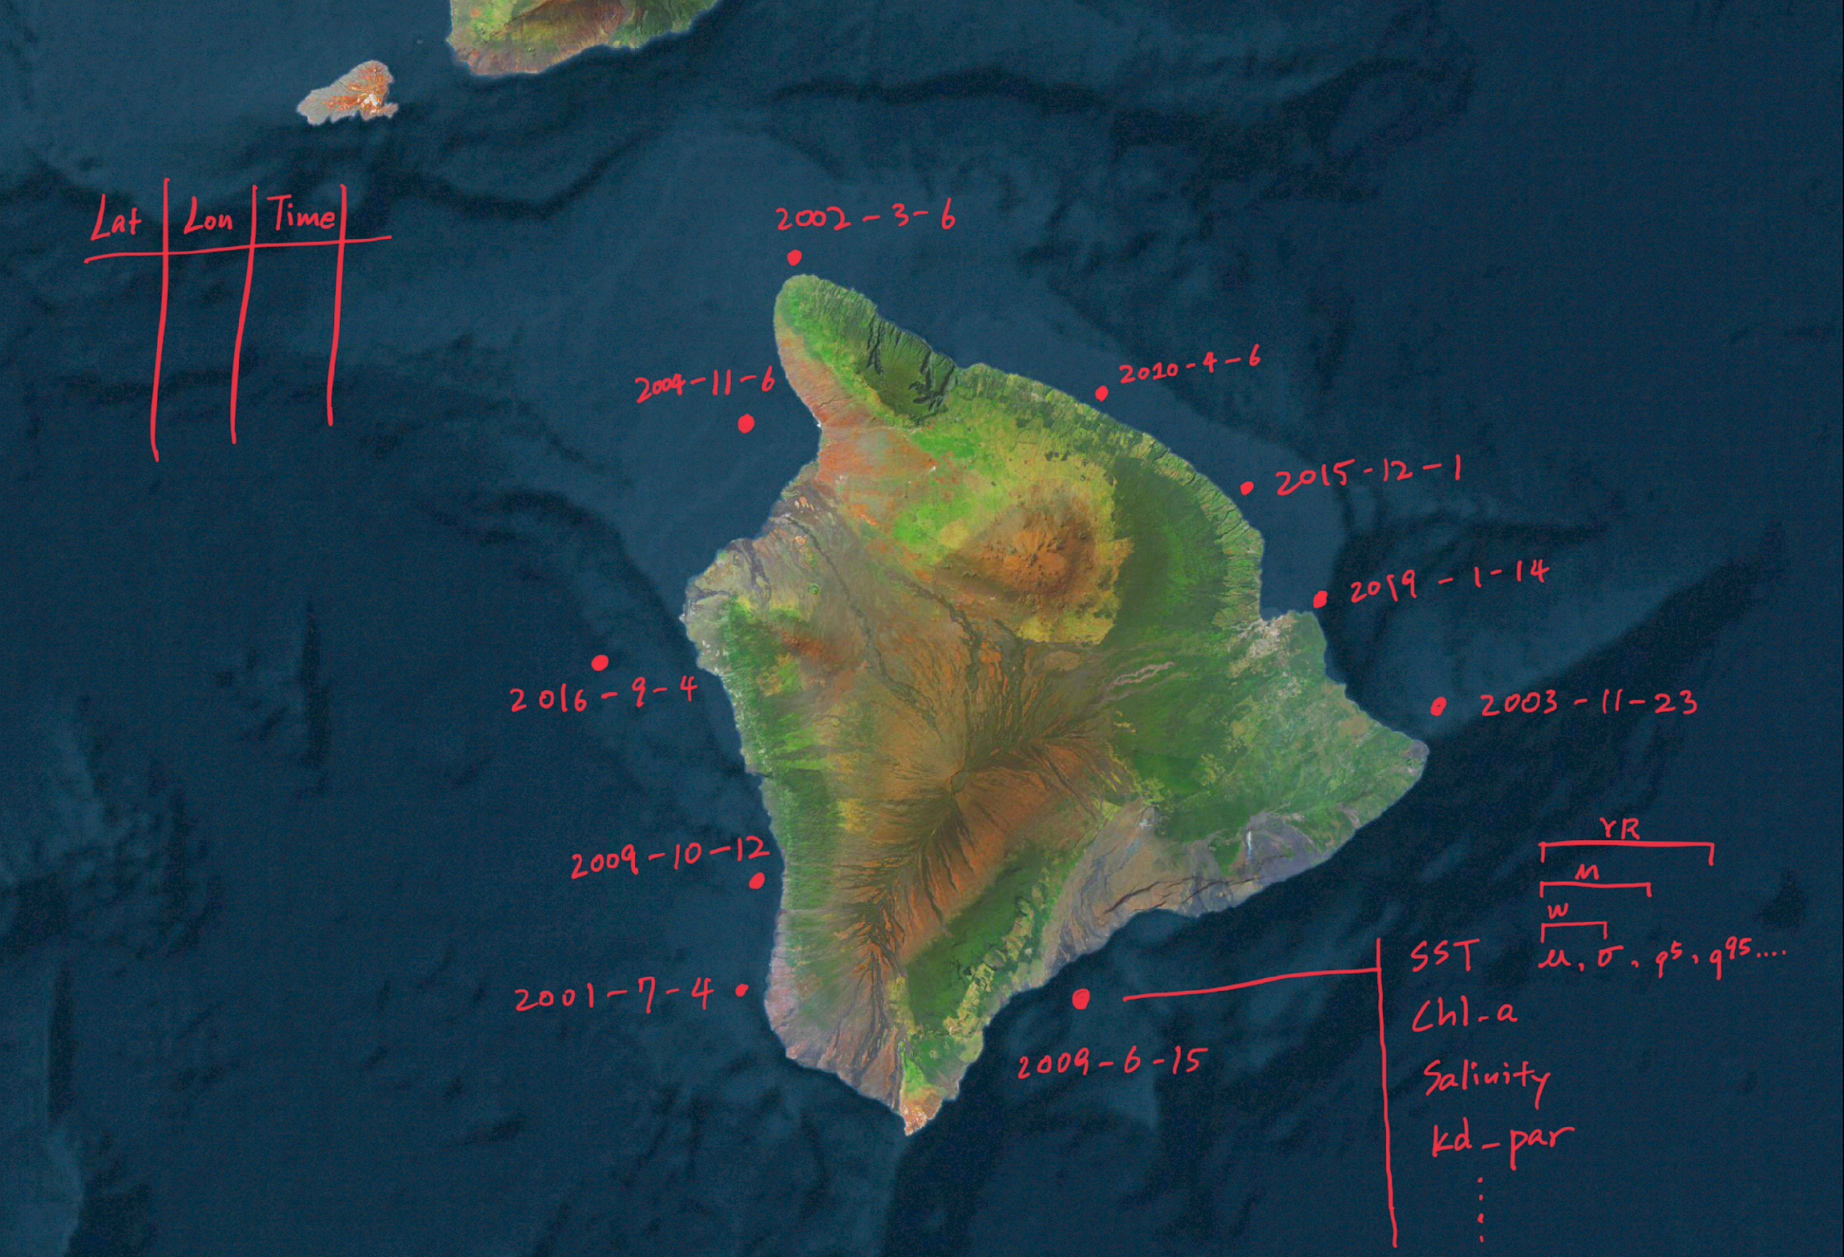

Slide 8
Why Git
Complete control on changes made to your system.
Best suited for reproducible research case studies, projects, tutorials, and media
An ideal team project management platform

Slide 9
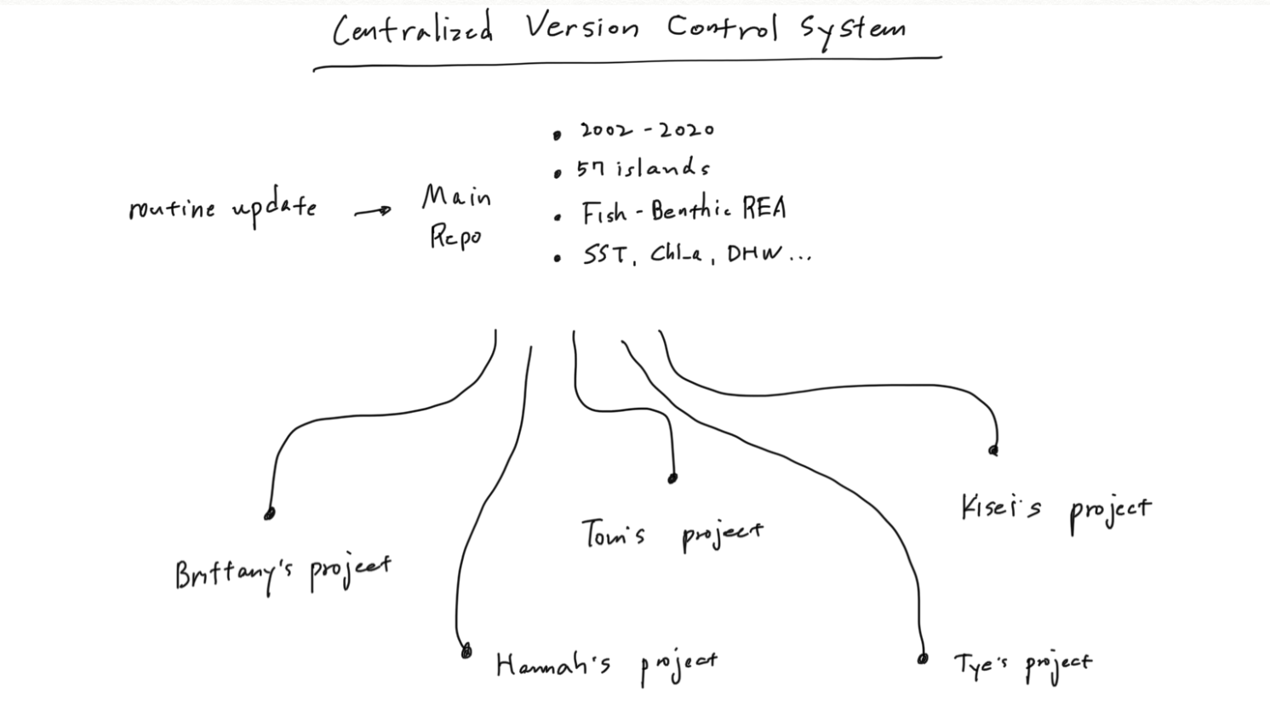

Slide 10
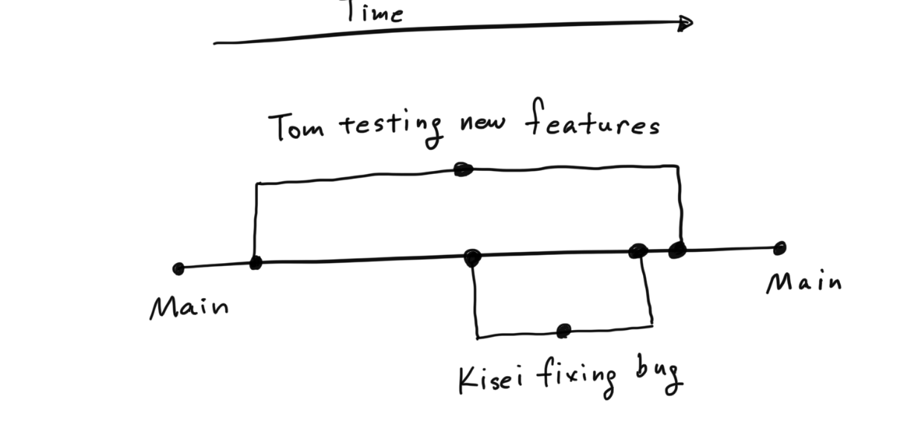

Slide 11
ERDDAP
an open-source data server to download scientific datasets in common file formats
Easy access to remote sensing data, climate data, fishery data…. Etc
OceanWatch (n=109) & Coastwatch (n=1739)
Pacific Islands Ocean Observing System (PacIOOS)
http://erddap.com/

Slide 12
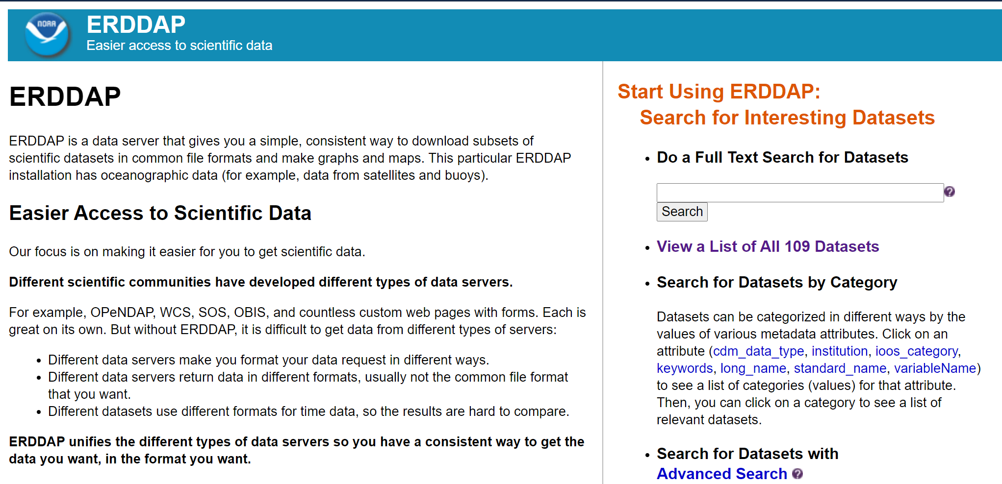

Slide 13
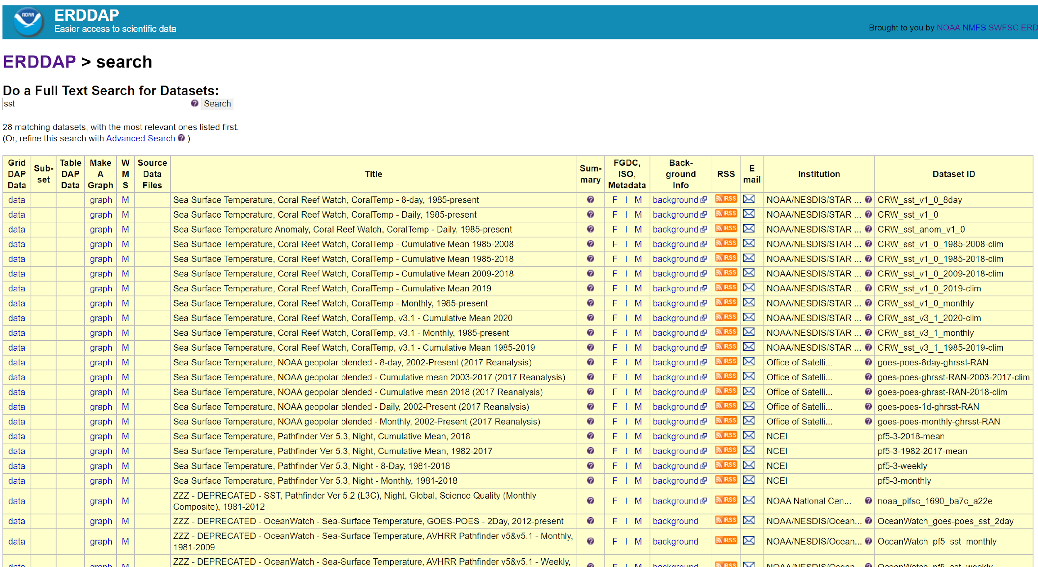

Slide 14
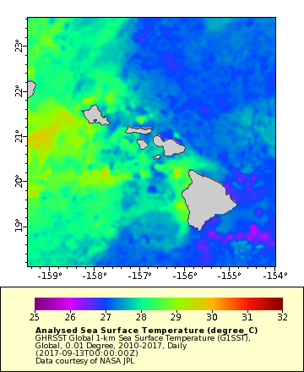
GHRSST Global 1-km Sea Surface Temperature (G1SST), Global, 0.01 Degree, 2010-2017, Daily

Slide 15
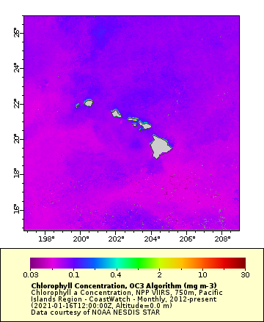
Chlorophyll a Concentration, NPP VIIRS, 750m, Pacific Islands Region - CoastWatch - Monthly, 2012-present

Slide 16
Clone & Run EDS program
Demo repo
https://github.com/krtanaka/eds_workshop_2021
Main repo
https://github.com/krtanaka/env_data_summary

Slide 17
EDS parameter file, what you need to enter
Customizable list of environmental variables to download
data/EDS_parameters.csv
Variable name,
temporal resolution, (day, 8 days, month, climatology)
ERDDAP URL,
dataset.ID,
Start and end date
Time steps
Summaries
Mask or non-mask

Slide 18
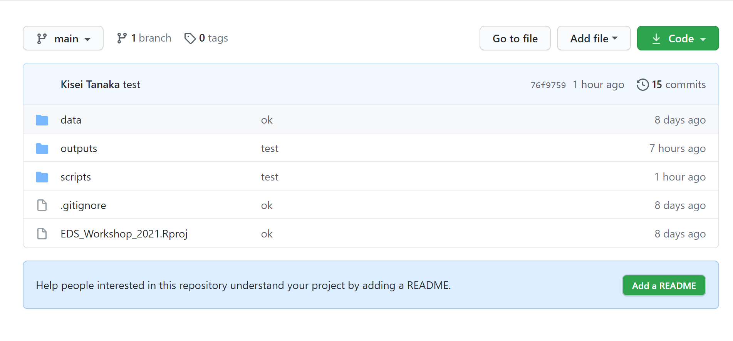

Slide 19
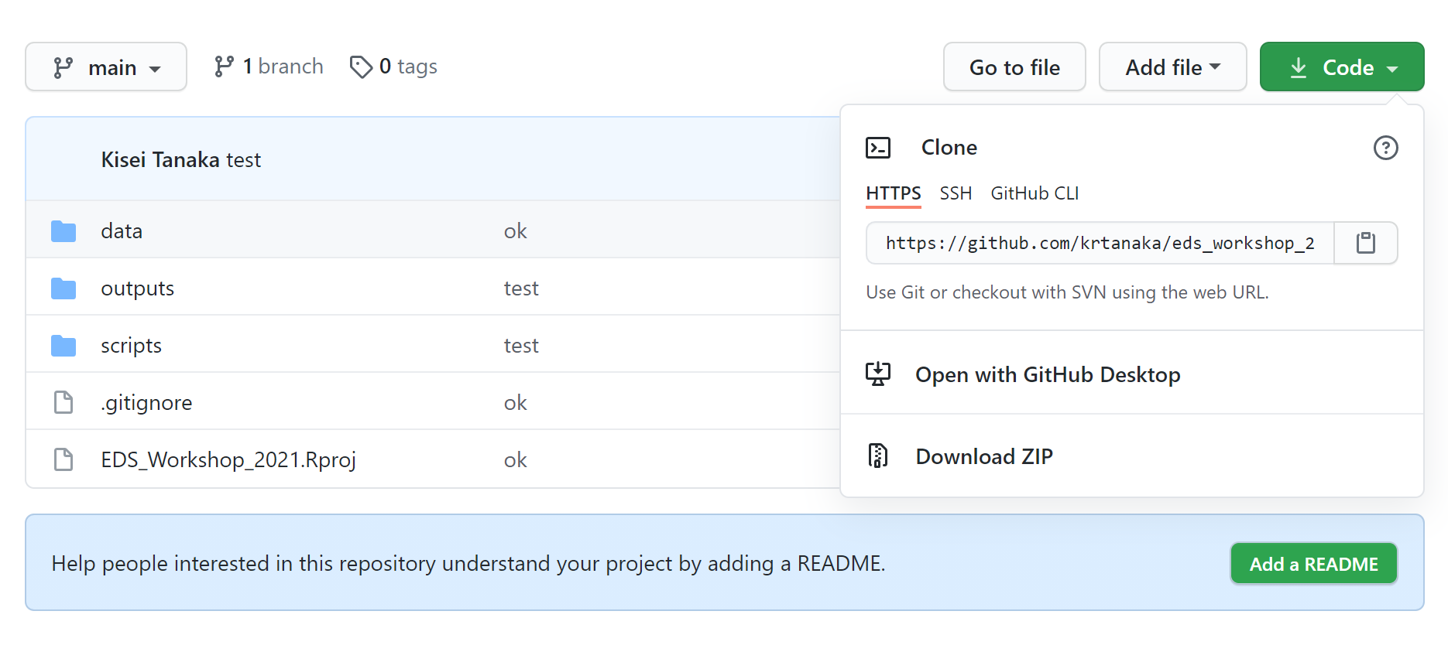

Slide 20
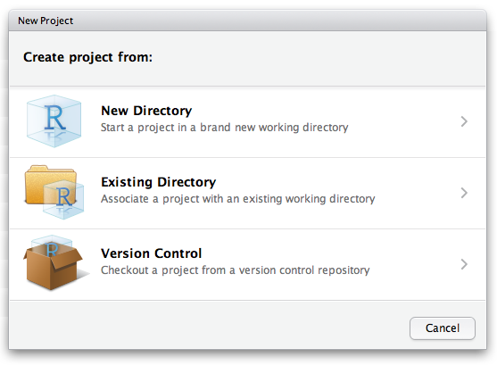
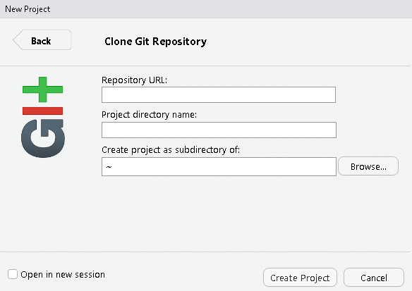

Slide 21
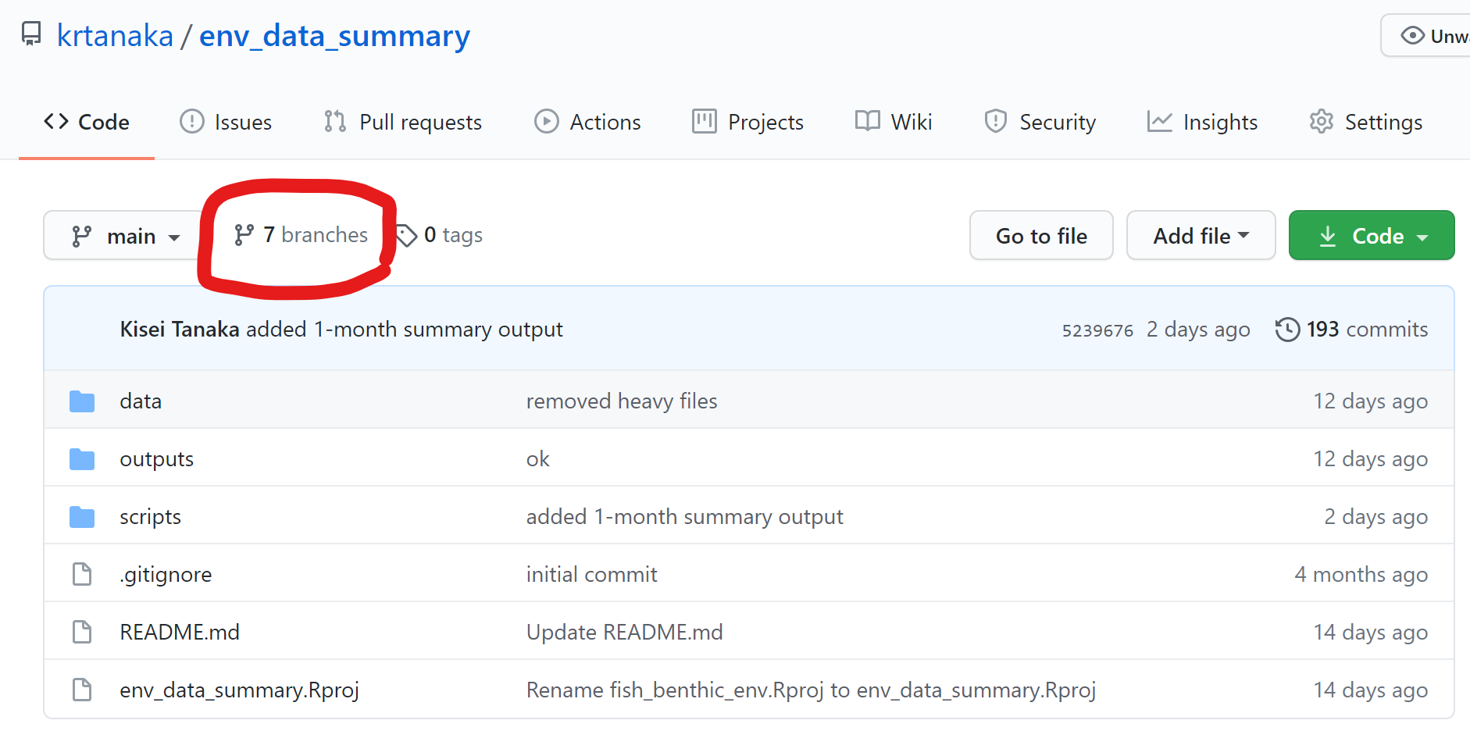
Branch & customize EDS program

Slide 22
